Slide 1
The Contribution of Health Economics to Health in the United States
Mark McClellan, MD, PhD
Brookings Institution

Slide 2
Overview:
Health Economics and Improving Health
Improving Health-Related Behaviors
Improving Health Care Delivery
Understanding the Macroeconomics of Health Care and Scientific Discovery
Creating “Big Team” Scientific Research

Slide 3
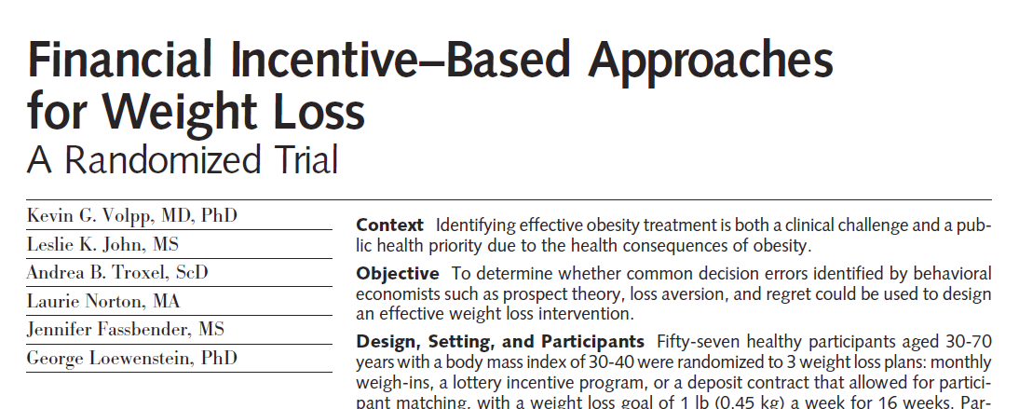

1. Improving health behaviors

Slide 4


2. Improving health care delivery
Jan 26 2011

Slide 5
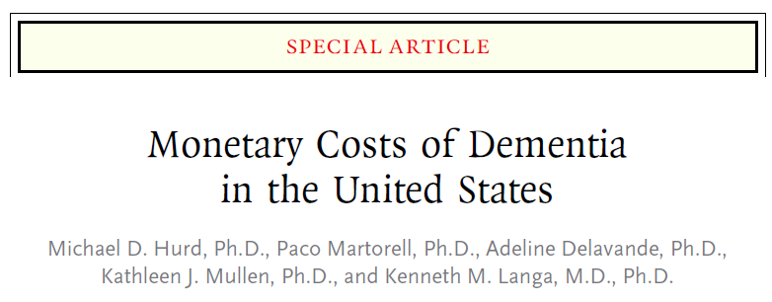

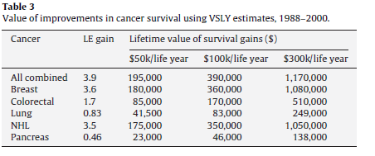
3. Understanding the macroeconomics of healthcare and scientific discovery
Lakdawalla et al., Journal
of Health Economics, 2010

Slide 6

4. Creating “big team” translational research

