Slide 1
Health Economics and the National Institute on Aging
Jonathan Skinner
Department of Economics, Dartmouth College
The Dartmouth Institute for Health Policy & Clinical Practice
jon.skinner@dartmouth.edu
May 18, 2011

Slide 2

How can health economics contribute to the NIA’s goal of improving the health of elderly?
“[T]he scientific effort to improve performance in medicine—an effort that at present gets only a miniscule of scientific budgets—can arguably save more lives in the next decade than bench science, more lives than research on the genome, stem cell therapy, cancer vaccines, and all the laboratory work we hear about in the news” (Atul Gawande, 2007)

Slide 3
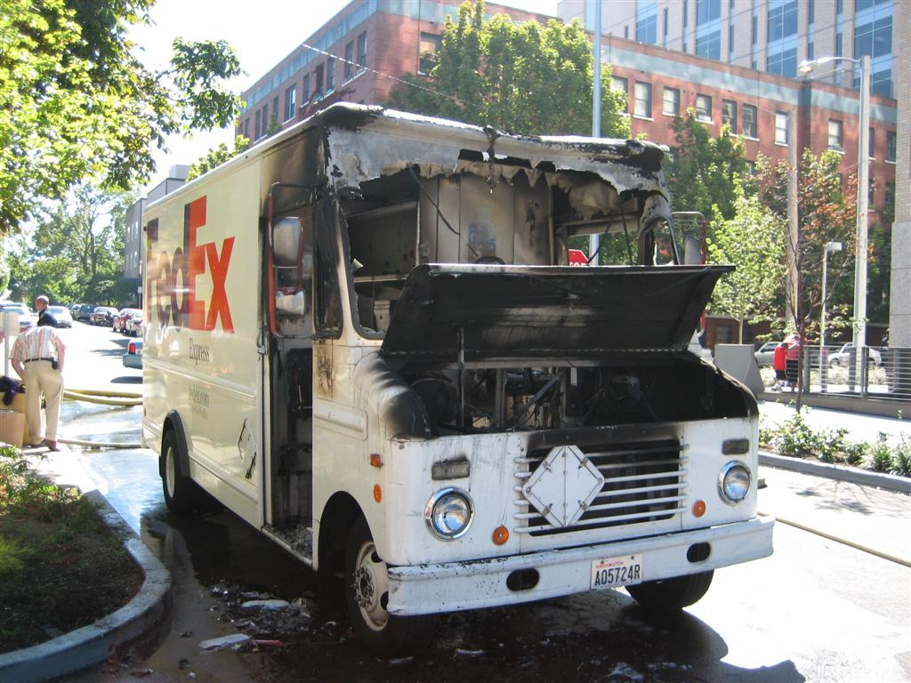
1. Improving insurance markets & saving Medicare/Medicaid from bankruptcy
      What are the health effects of health care insurance coverage? A randomized trial from Oregon (Kate Baicker et al.)

Slide 4
1. Improving insurance markets & saving Medicare/Medicaid from bankruptcy
      What are the health effects of health care insurance coverage? A randomized trial from Oregon (Kate Baicker et al.)
      Value-based insurance design – which drugs should be free – or subsidized? (Chandra et al., Am Econ Review, 2010; Chernew et al. )

Slide 5
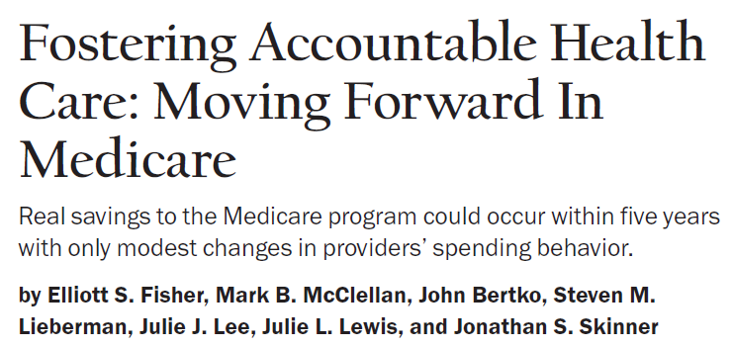
1. Improving insurance markets & saving Medicare/Medicaid from bankruptcy
      What are the health effects of health care insurance coverage? A randomized trial from Oregon (Kate Baicker et al.)
      Value-based insurance design – which drugs should be free – or subsidized? (Chandra et al., Am Econ Review, 2010; Chernew et al. )
      Developing new models of health care to “bend” the curve (Fisher, McClellan et al., Hlth Aff 2009)

Slide 6
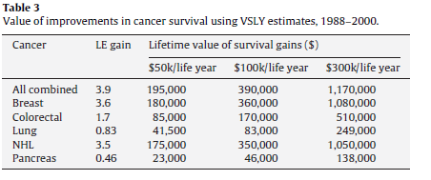
2. New approaches to measuring gains and inefficiency in U.S. health care
      Where is the effective care? (Lakdawalla, et al., J Health Econ, 2010)

Slide 7
2. New approaches to measuring gains and inefficiency in U.S. health care
      Where is the effective care? (Lakdawalla, et al., J Health Econ, 2010)
      Where is the ineffective care? (Gozalo et al, under review, 2011; Dartmouth Atlas, 2011)

Slide 8
A “misery index” for poor care in the advanced cognitively impaired (Range: 2% to 37% by state)
Gozalo et al., under second review, NEJM – not for distribution

Slide 9
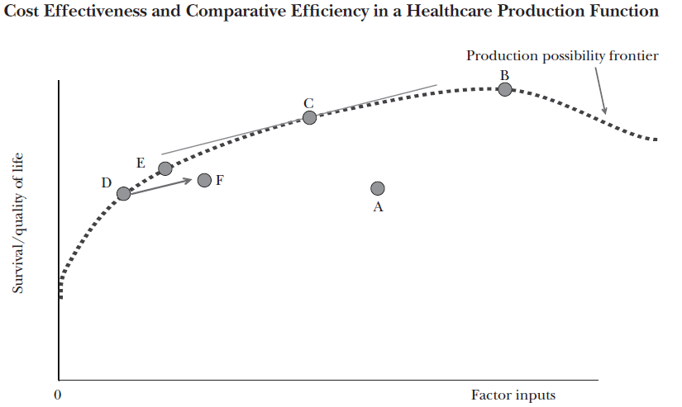
2. New approaches to measuring gains and inefficiency in U.S. health care
      Where is the effective care? (Lakdawall,
      aHealth Econ, 2010)
      Where is the ineffective care? (Teno et
      2010)
      Will comparative effectiveness help? (Perlroth et al., Demog, 2010; Chandra et al., JEP 2011)

Slide 10
3. Creating economies-of-scale in scientific innovation
      Spreading econometric methods for observational data to the clinical literature (e.g., Malenka et al., JAMA, 2008; Xian et al., JAMA, 2011)

Slide 11
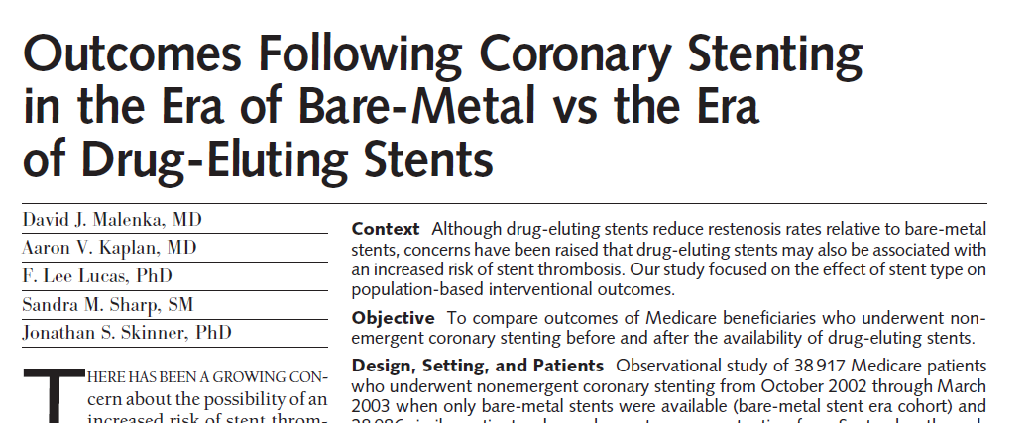
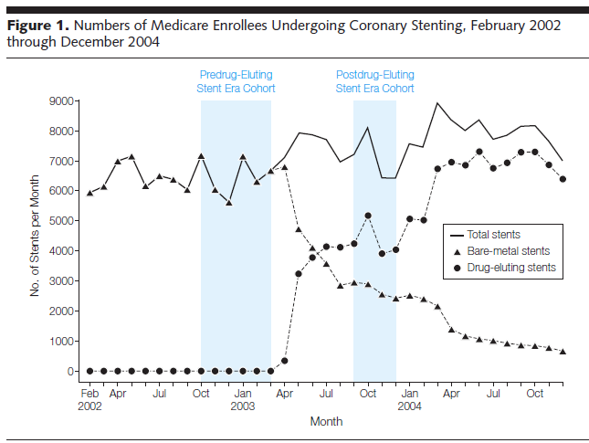
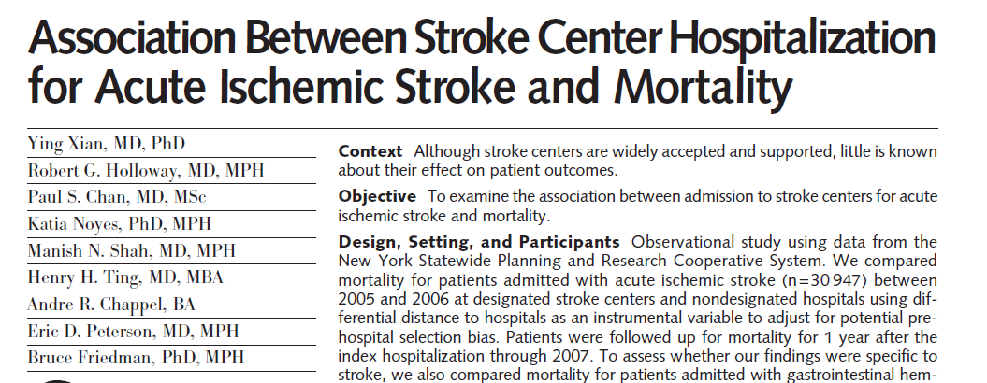
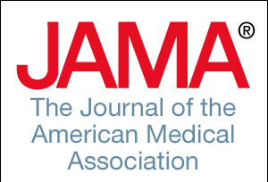
Discontinuity design & instrumental variables
June 21 2008
Jan 26 2011

Slide 12
3. Creating economies-of-scale in scientific innovation
      Diffusing econometric methods for observational data to the clinical literature (e.g., Malenka et al., JAMA, 2008; Xian et al., JAMA, 2011)
      Creating large collaborative research teams for “big science” in the economics of aging (e.g., health/wealth/aging)

Slide 13
Research teams required to sort this mess out……
Retirement incentives
Genotype
Wealth
Retirement status
Non-cognitive skills
Income
Cognitive skills
Health
Outcomes
Health care quality

Slide 14
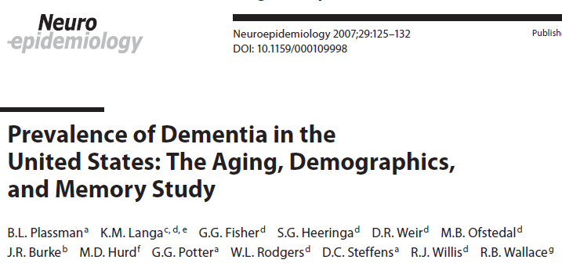
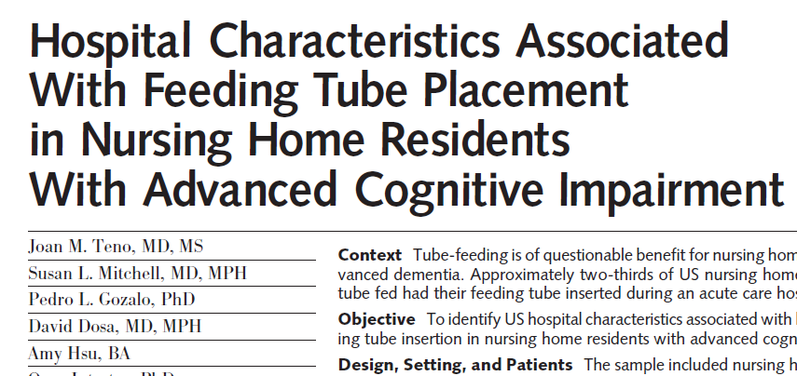
Examples of big-team translational research

